Slide 1

Virtual Reality
Meditation Visualisation System
GROUP 2
Zexi He, Tom Abbott,
Joshua Newbould, Dmitrie Bivol,
Cheng-Han Yang, Andrew DeVille

Slide 2
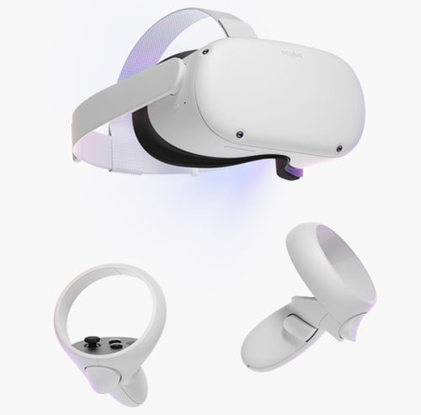
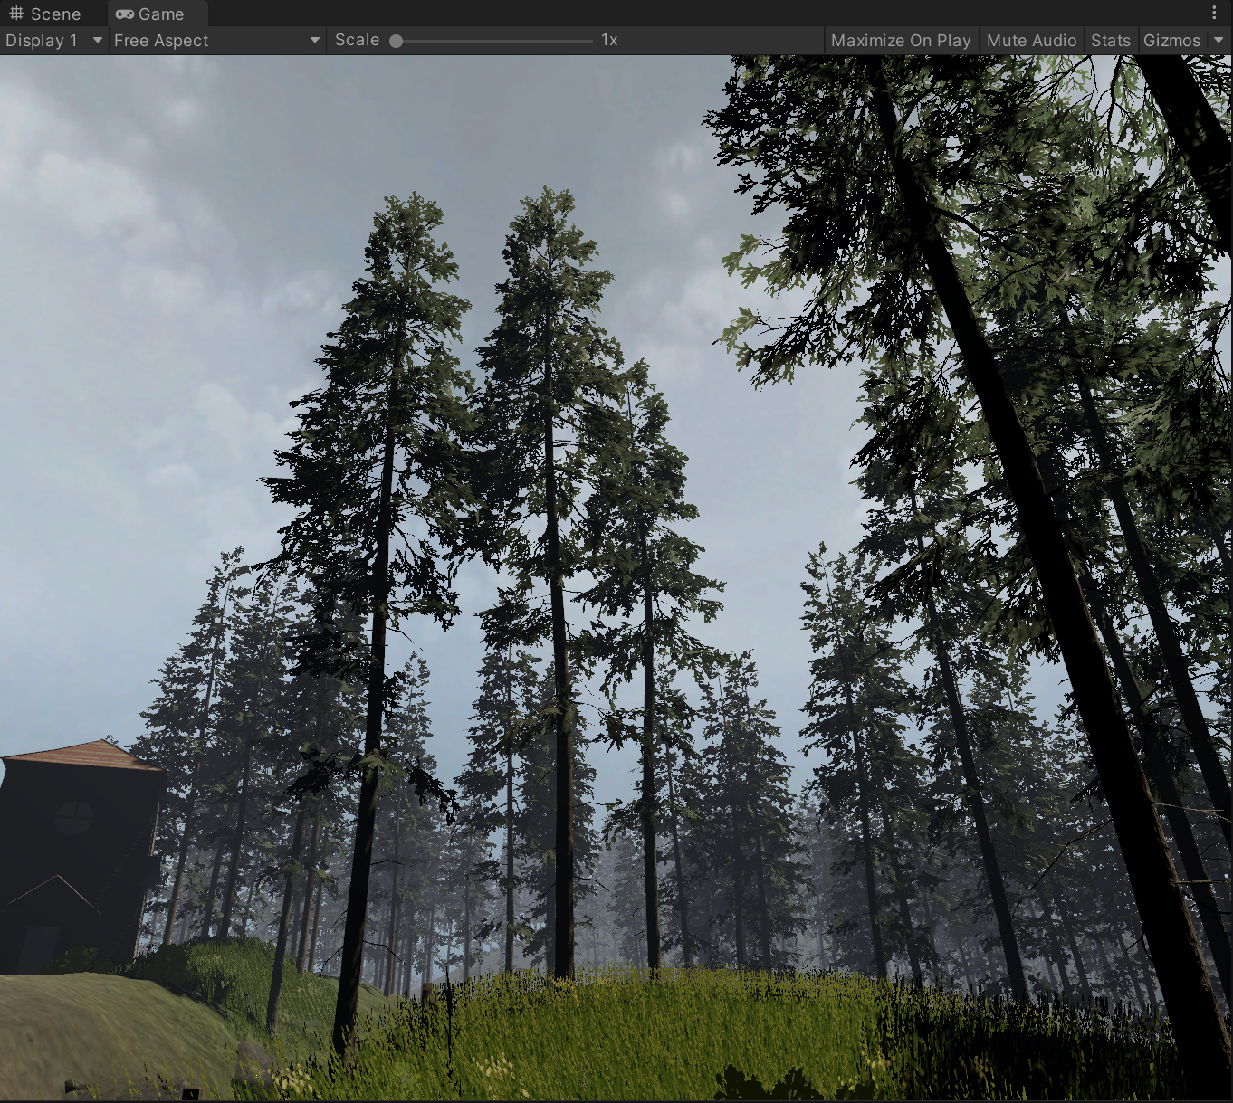

01
01
02
03
INTRO.
INTRO.
TECHNICAL.
FUTURE.

Slide 3


INTRO
CLIENT: Alexandra Cristea
Professor, Deputy Head, Director of Research and Head of the Artificial Intelligence in Human Systems research group in the Department of Computer Science at Durham University.
Research themes of AIHS include:
Human-centred computing
Trying to achieve natural interaction
Digital Humanities
Natural Language Processing

Slide 4


INTRO
Motivation
Stats:
Group or private meditation accounts for 7.4% of the alternative care market
Headspace has garnered over 65mil downloads has been valued at $320 million
Since 2012, the number of regular meditators has more than tripled
Improvements in computer graphics
Availability and support of VR

Slide 5



INTRO
Existing System
40+ environments
30+ hours of guided meditation on Anxiety, Depression, Maternity and other
200+ audio tracks
£10.99

Slide 6

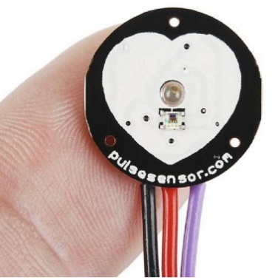
INTRO
Aim of our project
Durham Scene and other environments in high definition and animated
Meditation sessions of different length(5,10,20,30 mins)
Integration with body sensors
Heart rate sensor
Breathing rate sensor
Temperature sensor
Interesting graphs visualising this data for each meditation session
Gamification

Slide 7
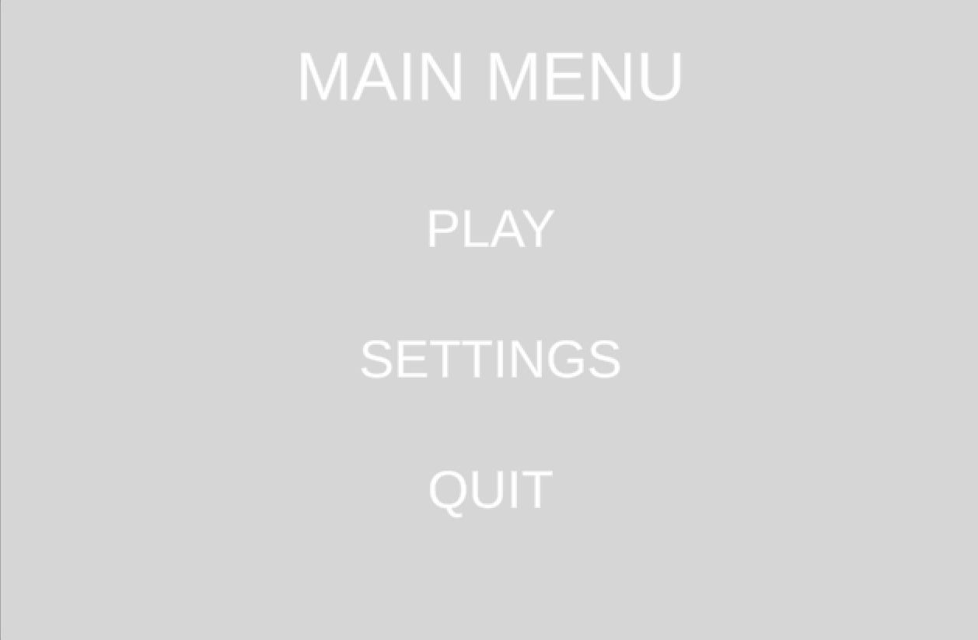

TECHNICAL.
This is the initial layout and concept of the menu for the vr meditation game. Further settings and design are to be added further into development to make sure the design is consistent throughout the game

Slide 8
TECHNICAL.
World modelling
-You should give some information about your client, the overall aims of the project and a very brief explanation of the important aspects of the system. You should give some information about your client.
--verall aims of the project and a very brief explanation of the important aspects of the system. You should give some information about your client, the overall aims of the project and a very brief explanation of the important aspects of the system.

Slide 9

TECHNICAL.
Demo
Riverside
More
scenes
Mutiple scenes
Durham
Building..

Slide 10


TEXT
VOICE
TECHNICAL.
-You should give some information about your client, the overall aims of the project and a very brief explanation of the important aspects of the system. You should give some information about your client.
-You should give some information about your client, the overall aims of the project and a very brief explanation of the important aspects of the system. You should give some information about your client.
TEXT INSTRUTIONS
&
GUIDES BY VOICE

Slide 11
DATABASE
CONTENT
DATA FLOW

Slide 12
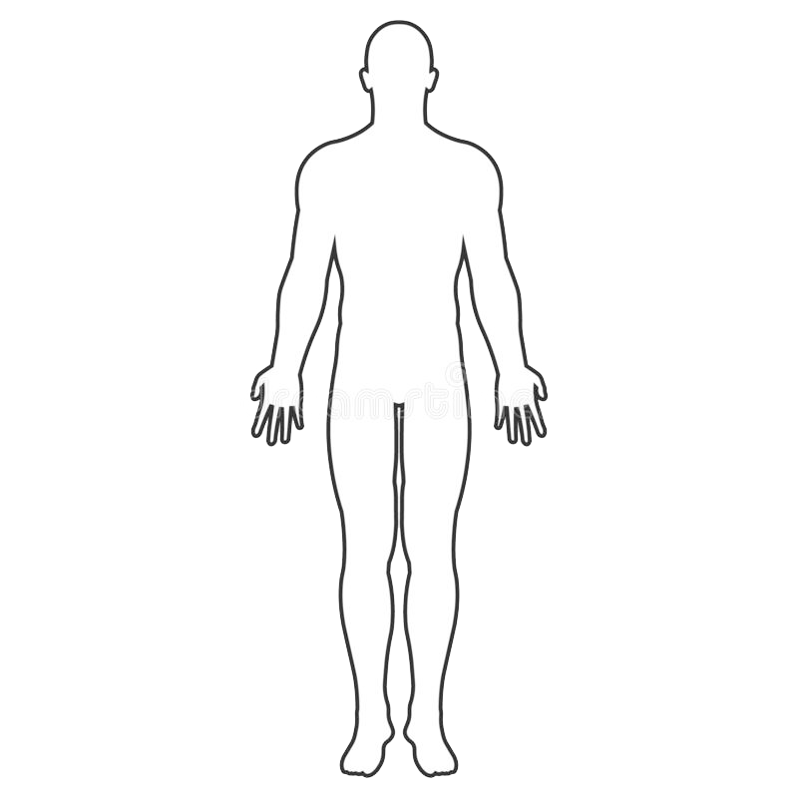
SENSOR DATA
Temperature
Headset
-You should give some information about your client, the overall aims of the project
-You should give some information about your client, the overall aims of the project and a very brief explanation of the important aspects of the system. You should give some information about your client.
Heart rate
-You should give some information about your client, the overall aims of the project

Slide 13
reports and usage tracking
Sensor Data
Reports
Awards
Headset
Time
Achievement unlocked
Score
Feature unlocked
Temperature
Quanlity
More....
Heart rate
Advice
.....

Slide 14



Working Style
-You should give some information about your client, the overall aims of the project and a very brief explanation of the important aspects of the system. You should give some information about your client.
-You should give some information about your client, the overall aims of the project and a very brief explanation of the important aspects of the system. You should give some information about your client.
-You should give some information about your client, the overall aims of the project and a very brief explanation of the important aspects of the system. You should give some information about your client.

Slide 15

Future WORK

Slide 16
TIMELINE
Future WORK
stage 1
stage 2
stage 3
-You should give some information about your client, the overall aims of the project and a very brief explanation of the important aspects of the system. You should give some information about your client.
-You should give some information about your client, the overall aims of the project and a very brief explanation of the important aspects of the system. You should give some information about your client.
-You should give some information about your client, the overall aims of the project and a very brief explanation of the important aspects of the system. You should give some information about your client.

Slide 17
TESTING
Future WORK
Feature
Feature
-provide users with a comfortable experience

